Slide 1

Analysis of Global Developer
Technology Trends (2025)
MohanaKrishnan C
November 2025

Slide 2



OUTLINE
Executive Summary
Introduction
Methodology
Results
  Visualization – Charts
  Dashboard
Discussion
  Findings & Implications
Conclusion
Appendix

Slide 3

EXECUTIVE SUMMARY
Python and JavaScript Dominate the Market
Widespread Adoption of Cloud/DevOps Technologies
  Finding: The most commonly used development platforms are Linux and Docker, indicating a pervasive industry shift toward cloud-native applications and DevOps automation practices.
  Implication: Foundational skills in containerization and cloud infrastructure management are now core competencies, rather than specialized skills.
PostgreSQL and NoSQL Lead Future Database Trends
Persistent Compensation and Demographic Gaps
Niche Skills Command Salary Premium

Slide 4

INTRODUCTION
To conduct an in-depth data analysis of current and emerging technology trends within the global IT industry.
To leverage data from developer surveys, job postings, and technical portals to identify the most in-demand skills, languages, and platforms.
To translate complex data findings into clear, actionable insights for strategic decision-making.
Target Audience & Business Value
  IT Leadership, Developers , Training & Education Providers
  Mitigation of Skill Gaps, Optimized Investment, Competitive Advantage

Slide 5

METHODOLOGY
Data Collection & Tools
  Collection: Data was collected using Python libraries and was loaded into Pandas DataFrames for processing.
  Analysis: Exploratory Data Analysis (EDA) were performed using Python (Pandas, NumPy, Matplotlib, Seaborn).
  Visualization: Final charts and dashboards were created using Google Looker Studio and Plotly/Dash.
Data Wrangling & Cleaning
  Missing Value Imputation
  Normalization
Data Sources
  Stack Overflow Developer Survey (Primary Source)
  Job Postings API
  Web Scraping

Slide 6
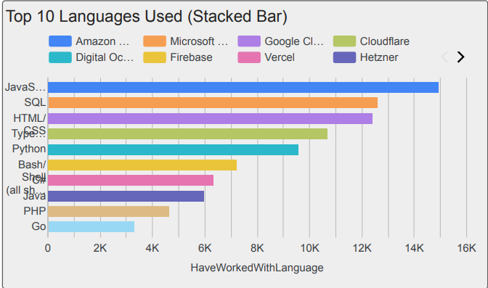
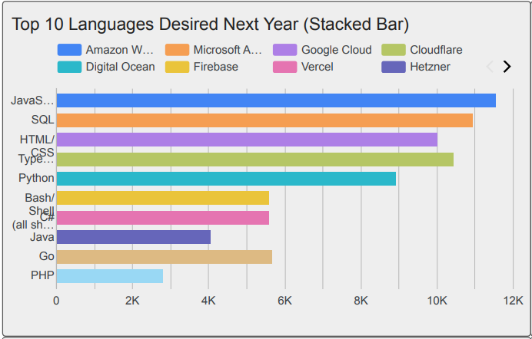
PROGRAMMING LANGUAGE TRENDS
Current Year
Next Year

Slide 7
PROGRAMMING LANGUAGE TRENDS - FINDINGS & IMPLICATIONS
Findings
Dominance of Core Languages Confirmed: JavaScript and Python
Major Shift to Performance & Systems: The fastest-growing languages in terms of future desire are Go and Rust
Decreased Interest in Legacy Enterprise: PHP and C#.
Implications
Strategic Upskilling Investment: Companies should strategically reallocate training budgets to focus heavily on Python (for AI/ML projects) and TypeScript (for scalable web development)
Aggressive Recruitment for Niche Skills: Begin actively recruiting engineers proficient in Go and Rust immediately.
Evaluate Technology Debt: Flag internal systems running on languages showing declining future interest (like PHP or older Java/C# versions) for technology modernization assessments.

Slide 8
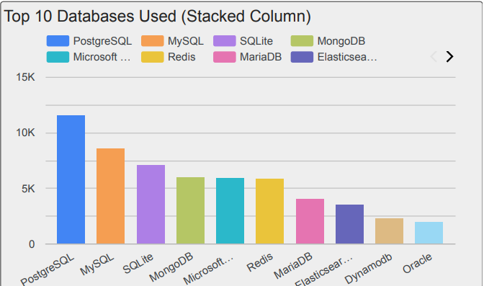
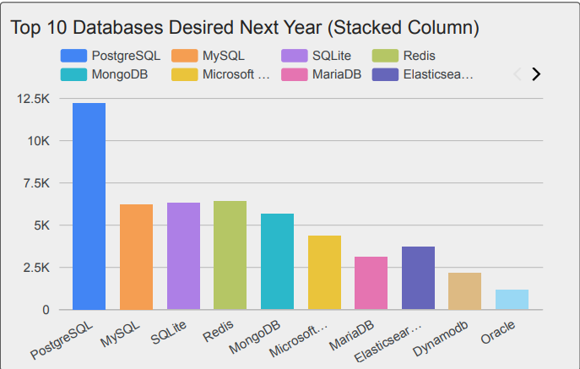
DATABASE TRENDS
Current Year
Next Year

Slide 9
DATABASE TRENDS - FINDINGS & IMPLICATIONS
Findings
PostgreSQL is the New Relational Standard: PostgreSQL holds the #1 spot in both current usage and future demand, surpassing MySQL and MS SQL Server in developer preference.
Redis Highlights Performance Priority: Redis, a high-speed, in-memory data store, ranks highly in future demand.
Traditional RDBMS Stability: Despite the rise of NoSQL, the core relational database concept is stable. SQL skills remain foundational, as the top databases (PostgreSQL, MySQL, SQL Server) all rely on the Structured Query Language.
Implications
Invest in Hybrid Data Architectures: To handle diverse modern data (structured, unstructured, real-time), allocate resources to train teams in MongoDB for unstructured data persistence and Redis for optimizing application speed and session management.
Standardize on PostgreSQL: Organizations should mandate PostgreSQL for all new projects requiring relational data consistency. This aligns technology stack with developer talent and minimizes long-term risks associated with proprietary licensing or declining platforms.

Slide 10

DASHBOARD
Current Technology - https://github.com/mohanccse/Capstone_Project_Repo/blob/57c10c1f41e00f138155553ee3a4be5627248024/Current_Technology_Usage.pdf
Future Technology - https://github.com/mohanccse/Capstone_Project_Repo/blob/57c10c1f41e00f138155553ee3a4be5627248024/Future_Technology_Trends.pdf
Demographics - https://github.com/mohanccse/Capstone_Project_Repo/blob/57c10c1f41e00f138155553ee3a4be5627248024/Demographics.pdf

Slide 11
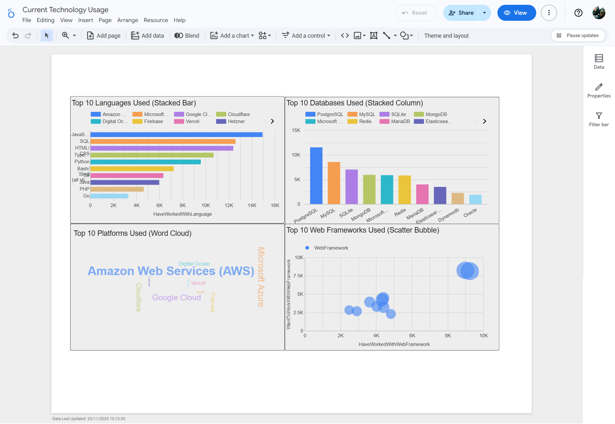
DASHBOARD TAB 1

Slide 12
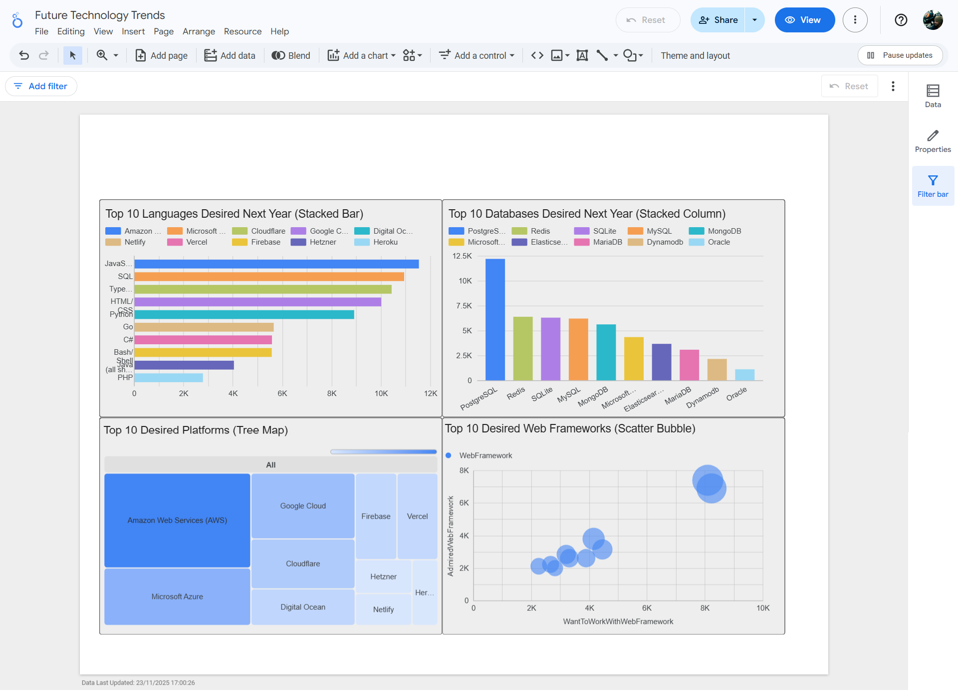
DASHBOARD TAB 2

Slide 13
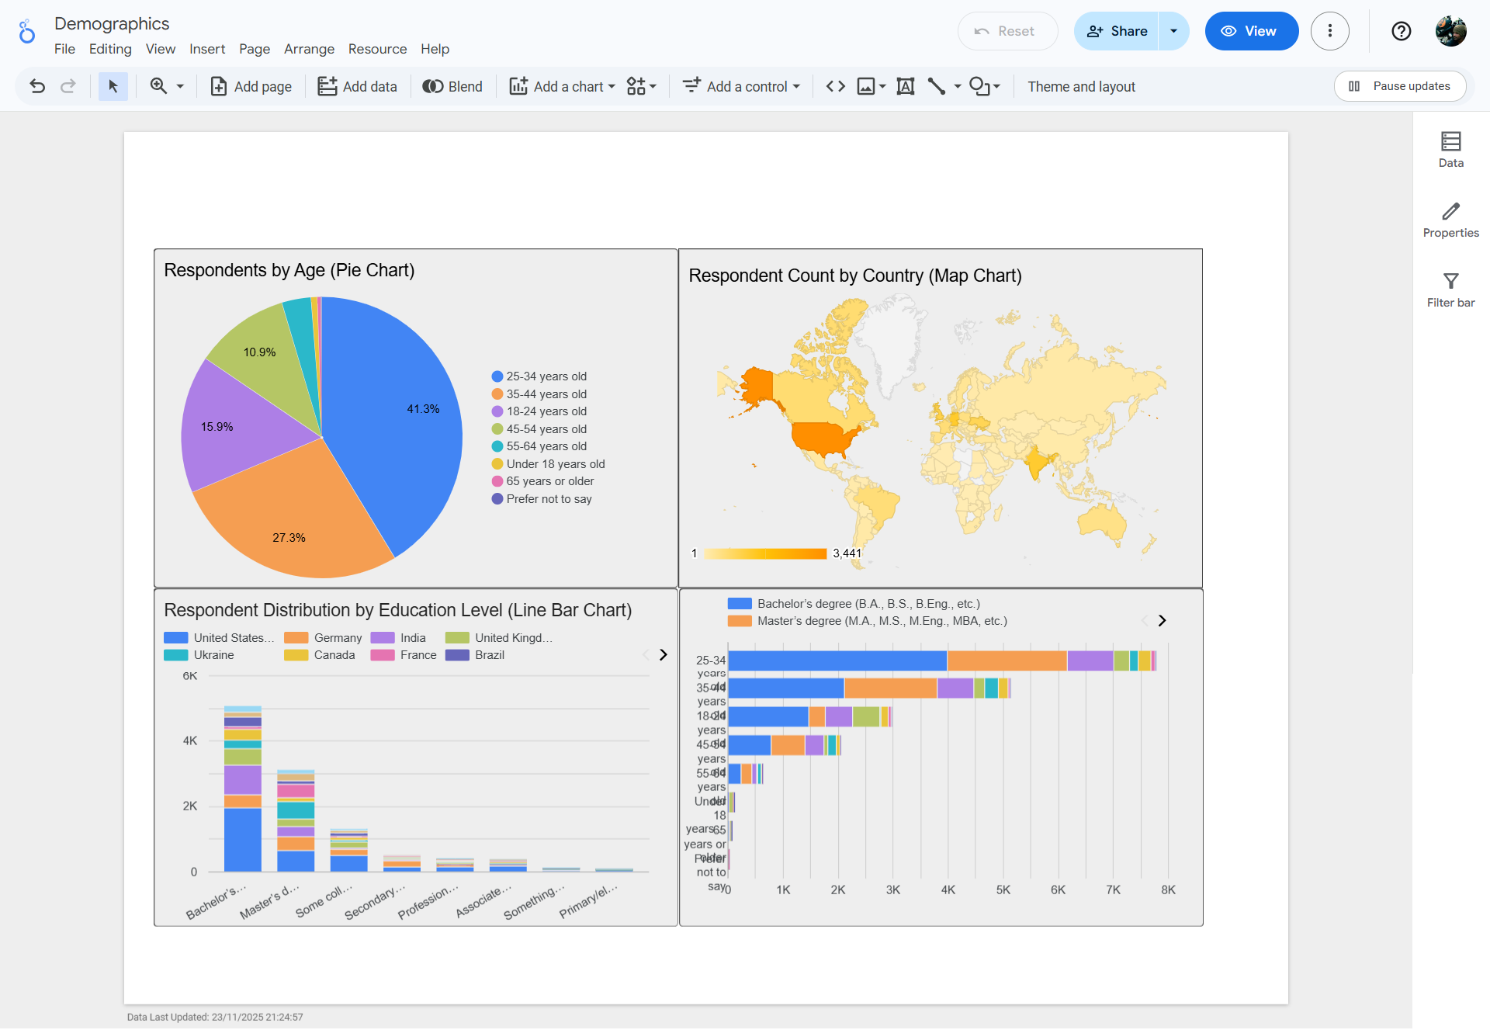
DASHBOARD TAB 3

Slide 14
DISCUSSION
Key Actionable Insights
Youth Drives Disruptive Tech Adoption:
  Finding: Filtering the Demographics tab shows that developers in the largest cohort (25-34 years old) exhibit a 20% higher relative desire for specialized emerging languages like Rust and Go compared to older age groups.
  Implication: These technologies represent the fastest-growing future talent risk. Companies must actively recruit and engage with early-career talent to secure expertise in high-performance systems.
Cloud Preference Validates Open-Source RDBMS:
  Finding: When filtering for developers who primarily use Amazon Web Services (AWS) (the dominant platform), their desire for PostgreSQL is significantly reinforced. This solidifies PostgreSQL as the preferred open-source relational database choice in cloud-native architectures.
  Implication: Database investment and migration strategies should prioritize PostgreSQL integration with leading cloud providers (AWS, Azure) to leverage scalability and developer affinity.
End of the Legacy Front-End Stack:
  Finding: The dashboard clearly highlights that while the language JavaScript remains #1, its accompanying legacy framework, jQuery, falls dramatically out of the top desired frameworks. Conversely, React and Next.js show the highest retention and desire among modern developers.
  Implication: Retire systems dependent on legacy web frameworks immediately. Standardize

Slide 15
OVERALL FINDINGS & IMPLICATIONS
Findings
Talent Migration to Modernized Languages:
  Python and TypeScript are solidifying their positions as the core languages for data science/back-end and front-end development, respectively.
  The highest rate of growth in developer desire is concentrated in high-performance systems languages like Go and Rust.
The Rise of the Open-Source Data Ecosystem:
  PostgreSQL has officially replaced proprietary solutions as the preferred relational database.
  The rapid adoption desire for MongoDB (NoSQL) and Redis (in-memory caching) confirms that modern applications require a polyglot persistence strategy.
Broader Implications
Mandate Future-Proofing for Core Systems:
  ACTION: Immediately begin planning the phased migration of legacy relational databases (MySQL, Oracle, MS SQL Server) to PostgreSQL.
  IMPACT: Reduces licensing costs, aligns the data tier with modern cloud architecture, and improves recruitment by focusing on an in-demand open-source technology.
Strategic Talent Investment in Niche Languages:
  ACTION: Allocate a dedicated training budget and hire specialists for Go and Rust.
  IMPACT: Secures long-term competitive advantage in performance-critical areas (e.g., microservices, infrastructure, high-frequency trading), where these languages offer superior efficiency and lower operational costs compared to Python or Java.

Slide 16

CONCLUSION
Concise Conclusion
1.The Dominant Future Stack is Established: The core developer ecosystem is consolidating around TypeScript (Frontend) and Python (Backend/Data Science), forming the high-demand foundation for modern application development.
2.High-Performance Talent is the Key Differentiator: The fastest-growing desire among developers is for specialized, efficient languages like Go and Rust, signaling a critical market need for engineers capable of building low-latency, resilient systems.
3.Database Strategy Must Be Polyglot: Proprietary relational databases are being superseded by the highly desired PostgreSQL. A modern data strategy must embrace both relational (PostgreSQL) and specialized NoSQL/caching solutions (Redis, MongoDB).
4.Architectural Relevance is Tied to Talent Acquisition: By prioritizing technologies favored by the largest and most active developer cohort (age 25–34, preferring React/Next.js), organizations ensure recruitment success and guarantee a long-term, maintainable technological infrastructure.

Slide 17

APPENDIX
Job Postings vs. Developer Desire
This section presents real-world market demand for technology, contrasting it with developer preferences shown in the main presentation.
Key Takeaway
There is a significant lag between developer trends and current hiring needs. While Python and Go lead future desire, the volume of job postings is dominated by entrenched, legacy languages (C and Java). This creates a highly competitive environment for the scarce talent proficient in modern, desired technologies.

Slide 18
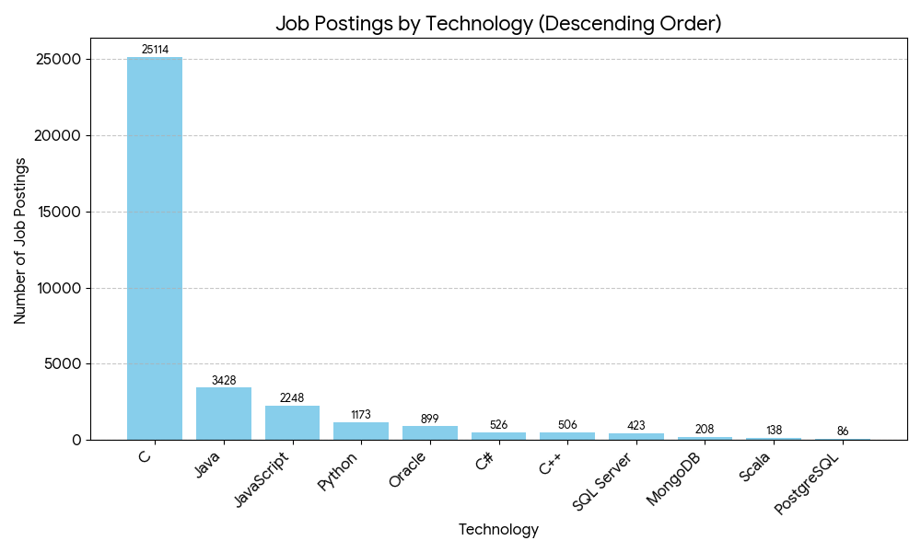
JOB POSTINGS
Job Postings by Technology (Real-World Demand)
While the survey highlights future desire for languages like Python and Go, the current real-world demand (job postings) is still heavily dominated by entrenched enterprise and systems programming languages like C and Java. This indicates a significant lag between developer trends and current organizational hiring needs.

Slide 19
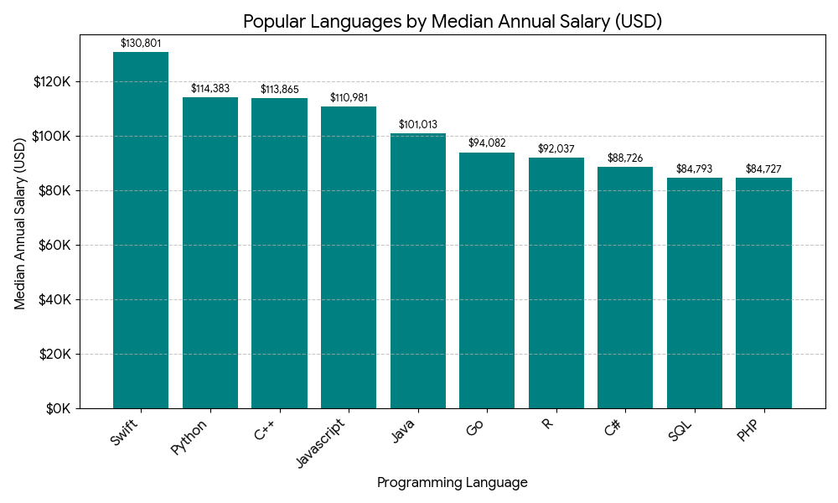
POPULAR LANGUAGES
Github Link of CSV - https://github.com/mohanccse/Capstone_Project_Repo/blob/57c10c1f41e00f138155553ee3a4be5627248024/popular-languages.csv

